Slide 1


National Institute of Technology Raipur
“Packet Filtering”
Submitted by:
Bhaumik Katiyar (14118010)
Aishwarya Bhave (14118006)
Manu Gupta (14118035)
Aditya Gangeley (14118004)
Submitted to:
Mr. Anuj Rai
Dept. of Information Technology
NIT Raipur

Slide 2
Objectives
Describe packets and packet filtering
Explain the approaches to packet filtering
Recommend specific filtering rules
1

Slide 3
Introduction
Packets: discrete blocks of data; basic unit of data handled by a network
Packet filter: hardware or software designed to block or allow transmission of packets based on criteria such as port, IP address, protocol
To control movement of traffic through the network perimeter, know how packets are structured and what goes into packet headers
2

Slide 4
Understanding Packets and Packet Filtering
Packet filter inspects packet headers before sending packets on to specific locations within the network
A variety of hardware devices and software programs perform packet filtering:
  Routers: probably most common packet filters
  Operating systems: some have built-in utilities to filter packets on TCP/IP stack of the server software
  Software firewalls: most enterprise-level programs and personal firewalls filter packets
3

Slide 5
Anatomy of a IP Packet
Header
  Contains IP source and destination addresses
  Not visible to end users
Data
  Contains the information that it is intending to send (e.g., body of an e-mail message)
  Visible to the recipient
4

Slide 6
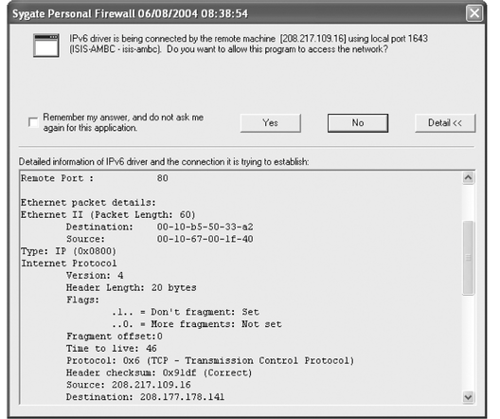
Anatomy of a IP Packet (continued)
5

Slide 7
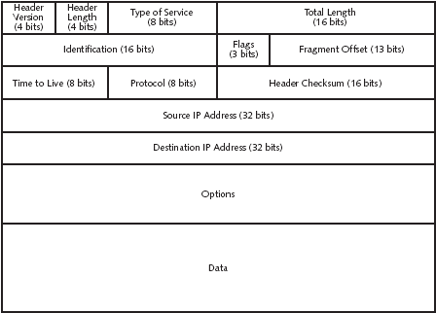
Anatomy of a IP Packet (continued)
6

Slide 8
Packet-Filtering Rules
Packet filtering: procedure by which packet headers are inspected by a router or firewall to make a decision on whether to let the packet pass
Header information is evaluated and compared to rules that have been set up (Allow or Deny)
Packet filters examine only the header of the packet.
7

Slide 9
Packet-Filtering Rules (continued)
Drop all inbound connections; allow only outbound connections on Ports 80 (HTTP), 25 (SMTP), and 21 (FTP)
Eliminate packets bound for ports that should not be available to the Internet (e.g., NetBIOS)
Filter out ICMP redirect or echo (ping) messages (may indicate hackers are attempting to locate open ports or host IP addresses)
Drop packets that use IP header source routing feature
8

Slide 10
Packet-Filtering Rules (continued)
Set up an access list that includes all computers in the local network by name or IP address so communications can flow between them
  Allow all traffic between “trusted” hosts
  Set up rules yourself
9

Slide 11
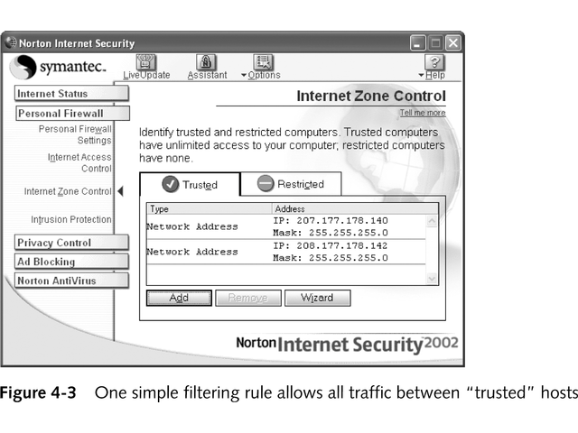
Packet-Filtering Rules (continued)
10

Slide 12
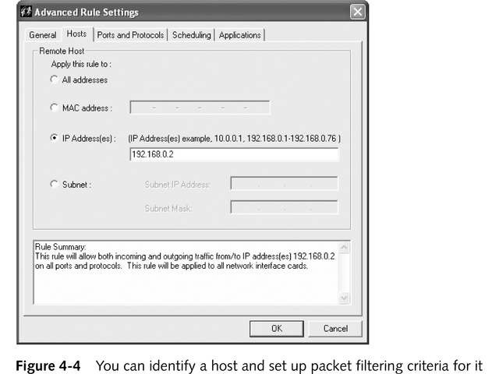
Packet-Filtering Rules (continued)
11

Slide 13
Packet-Filtering Methods
Stateless packet filtering
Stateful packet filtering
12

Slide 14
Stateless Packet Filtering
Determines whether to block or allow packets—based on several criteria—without regard to whether a connection has been established
Also called static packet filtering
Useful for completely blocking traffic from a subnet or other network
13

Slide 15
Criteria That a Stateless Filter Can Be Configured to Use
IP header information
TCP or UDP port number being used
Internet Control Message Protocol (ICMP) message type
Fragmentation flags (e.g., ACK and SYN)
14

Slide 16
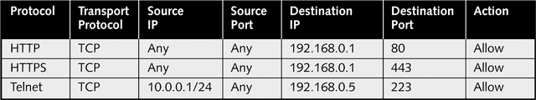
Filtering on IP Header Criteria
Packet’s source IP address
Destination or target IP address
Specify a protocol for the hosts to which you want to grant access
IP protocol ID field in the header
15

Slide 17
Filtering by TCP or UDP Port Number
Helps filter wide variety of information
  SMTP and POP e-mail messages
  NetBIOS sessions
  DNS requests
  Network News Transfer Protocol (NNTP) newsgroup sessions
Commonly called port filtering or protocol filtering
16

Slide 18
Filtering by ICMP Message Type
ICMP helps networks cope with communication problems
No authentication method; can be used by hackers to crash computers on the network
Firewall/packet filter must be able to determine, based on its message type, whether an ICMP packet should be allowed to pass
17

Slide 19
Filtering by Fragmentation Flags
Security considerations
  TCP or UDP port number is provided only at the beginning of a packet; appears only in fragments numbered 0
  Fragments numbered 1 or higher will be passed through the filter
  If a hacker modifies an IP header to start all fragment numbers of a packet at 1 or higher, all fragments will go through the filter
18

Slide 20
Filtering by Fragmentation Flags (continued)
Configuration considerations
  Configure firewall/packet filter to drop all fragmented packets
  Have firewall reassemble fragmented packets and allow only complete packets to pass through
19

Slide 21
Filtering by ACK Flag
ACK flag
  Indicates whether a packet is requesting a connection or whether the connection has already been established
  A hacker can insert a false ACK bit of 1 into a packet
Configure firewall to allow packets with the ACK bit set to 1 to access only the ports you specify and only in the direction you want
20

Slide 22
Filtering Suspicious Inbound Packets
Firewall sends alert message if a packet arrives from external network but contains an IP address from inside network
Most firewalls let users decide whether to permit or deny the packet
  Case-by-case basis
  Automatically, by setting up rules
21

Slide 23
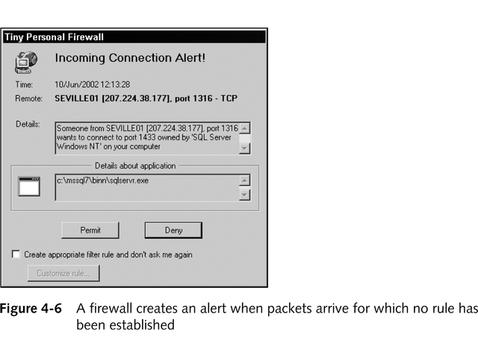
Filtering Suspicious Inbound Packets (continued)
22

Slide 24
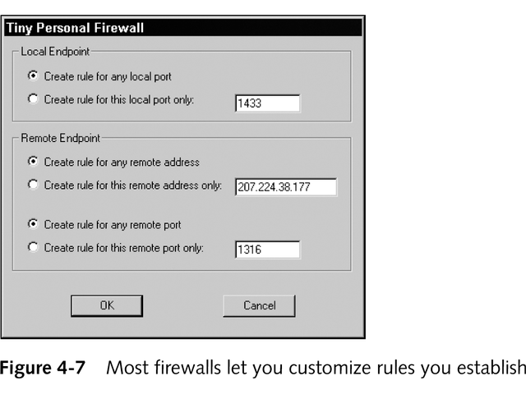
Filtering Suspicious Inbound Packets (continued)
23

Slide 25
Stateful Packet Filtering
Performs packet filtering based on contents of the data part of a packet and the header
Filter maintains a record of the state of a connection; allows only packets that result from connections that have already been established
More sophisticated and secure
Has a rule base and a state table
24

Slide 26
Filtering Based on Packet Content
Stateful inspection
Proxy gateway
Specialty firewall
25

Slide 27
Setting Specific Packet-Filter Rules
Rules to filter potentially harmful packets
Rules to pass packets that you want to be passed through
26

Slide 28
Best Practices for Firewall Rules
All traffic from trusted network is allowed out
Firewall device is never accessible directly from public network
SMTP data allowed to pass through firewall but all is routed to well-configured SMTP gateway
All ICMP data is denied
Telnet access to all internal servers from public networks is blocked
When Web services are offered outside firewall, implement proxy access or DMZ architecture
27

Slide 29
Rules That Cover Multiple Variations
Must account for all possible ports that a type of communication might use or for all variations within a protocol
28

Slide 30
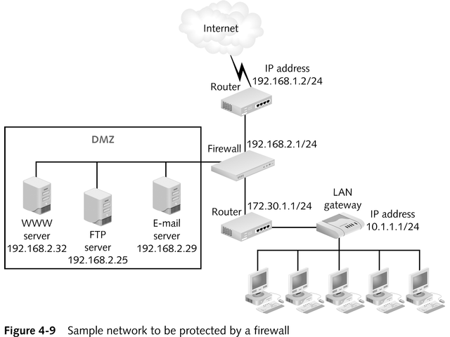
Sample Network to Be Protected by a Firewall

Slide 31
Rules for ICMP Packets
ICMP lets you test network connectivity and makes you aware of communications problems
Rules are especially important because ICMP packets can be easily forged and used to redirect other communications
30

Slide 32
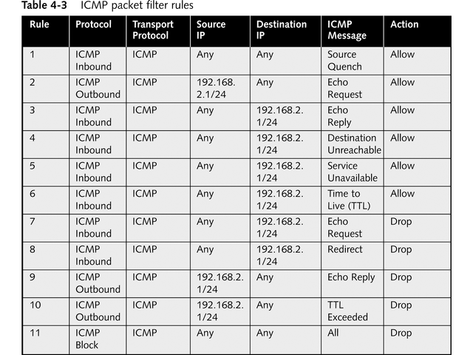
ICMP Packet-Filter Rules
31

Slide 33
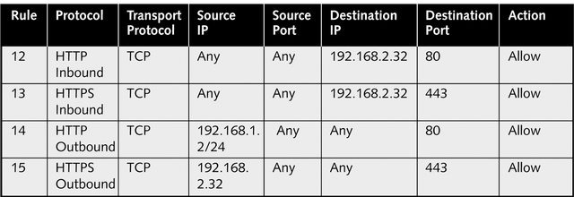
Rules That Enable Web Access
Rules need to cover both standard HTTP traffic on TCP Port 80 as well as Secure HTTP (HTTPS) traffic on TCP Port 443
32

Slide 34
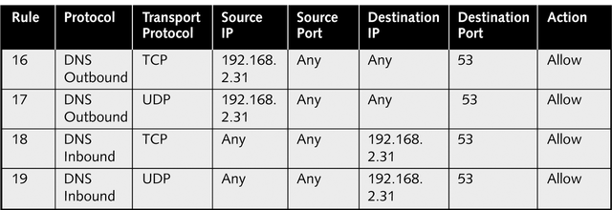
Rules That Enable DNS
Set up rules that enable external clients to access computers in your network using the same TCP and UDP ports
33

Slide 35
Rules That Enable FTP
Rules need to support two separate connections
  TCP Port 21 (FTP Control port)
  TCP 20 (FTP Data port)
34

Slide 36
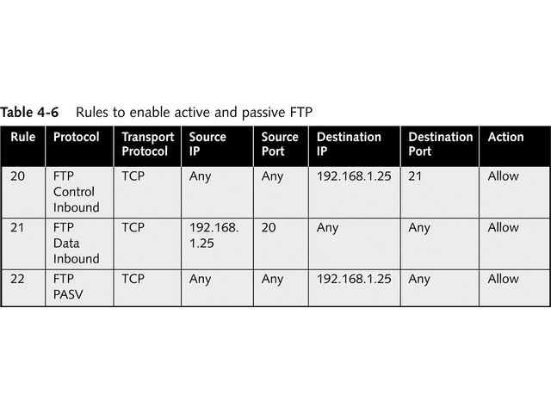
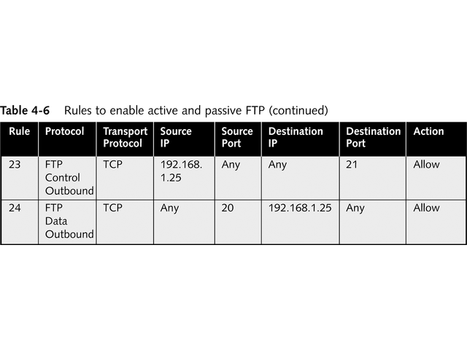
Rules That Enable FTP (continued)

Slide 37
Rules That Enable E-Mail
Complicated; a variety of protocols might be used
  For inbound mail transport
    Post Office Protocol version 3 (POP3)
    Internet E-mail Access Protocol version 4 (IMAP4)
  For outbound mail transport
    Simple Mail Transfer Protocol (SMTP)
  For looking up e-mail addresses
    Lightweight Directory Access Protocol (LDAP)
  For Web-based mail service
    HyperText Transport Protocol (HTTP)
36

Slide 38
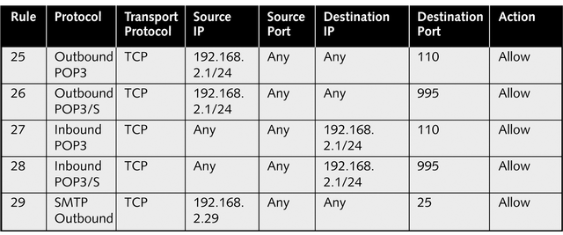
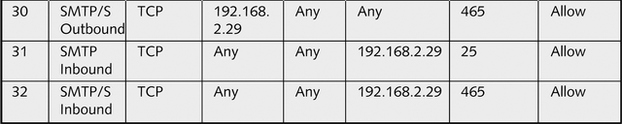
POP3 and SMTP E-Mail Rules

Slide 39
Chapter Summary
Packet header criteria that can be used to filter traffic
Approaches to packet filtering
Specific packet-filter rules
38

